Slide 1
Finding profitable cointegrated pairs for implementing a high frequency trading strategy using S&P 500 companies
Using unsupervised clustering and time series analysis
Archana Singh Parihar

Slide 2
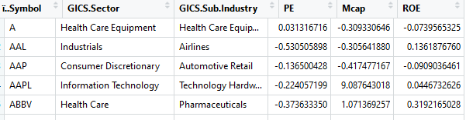
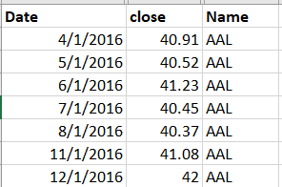
Datasets and Data Cleaning
Dataset 1 : S&P500 Companies Number of rows : 505
Categorical variables : 2 Numerical variables : 3
Dataset 2 : Stock price data from 2013 to 2018 Year 2013- 2015: Number of rows : 3,54,552
Year 2016- 2018: Number of rows : 1,05,991

Slide 3
Trading Strategy - Pair Based Trading
Hedged Position A short sale makes money when the security sold, LOSES value. And a long purchase makes money if the security purchased, GAINS value. In the case of two securities, we call it a hedged position when we go LONG on one security and go SHORT on the other. So how do we make money, maintaining a hedged position ? - If both securities go up together or both go down together, we make no money. BUT we make money if both of them are at some point reverting to the mean. Going Long the spread = this is when the spread(distance bet two) is small and we expect it to become Larger. We place a bet on this by longing Y and shorting X. Going Short the spread = this is when the spread(distance bet two) is large and we expect it to become smaller. We place a bet on this by longing X and shorting Y.

Slide 4
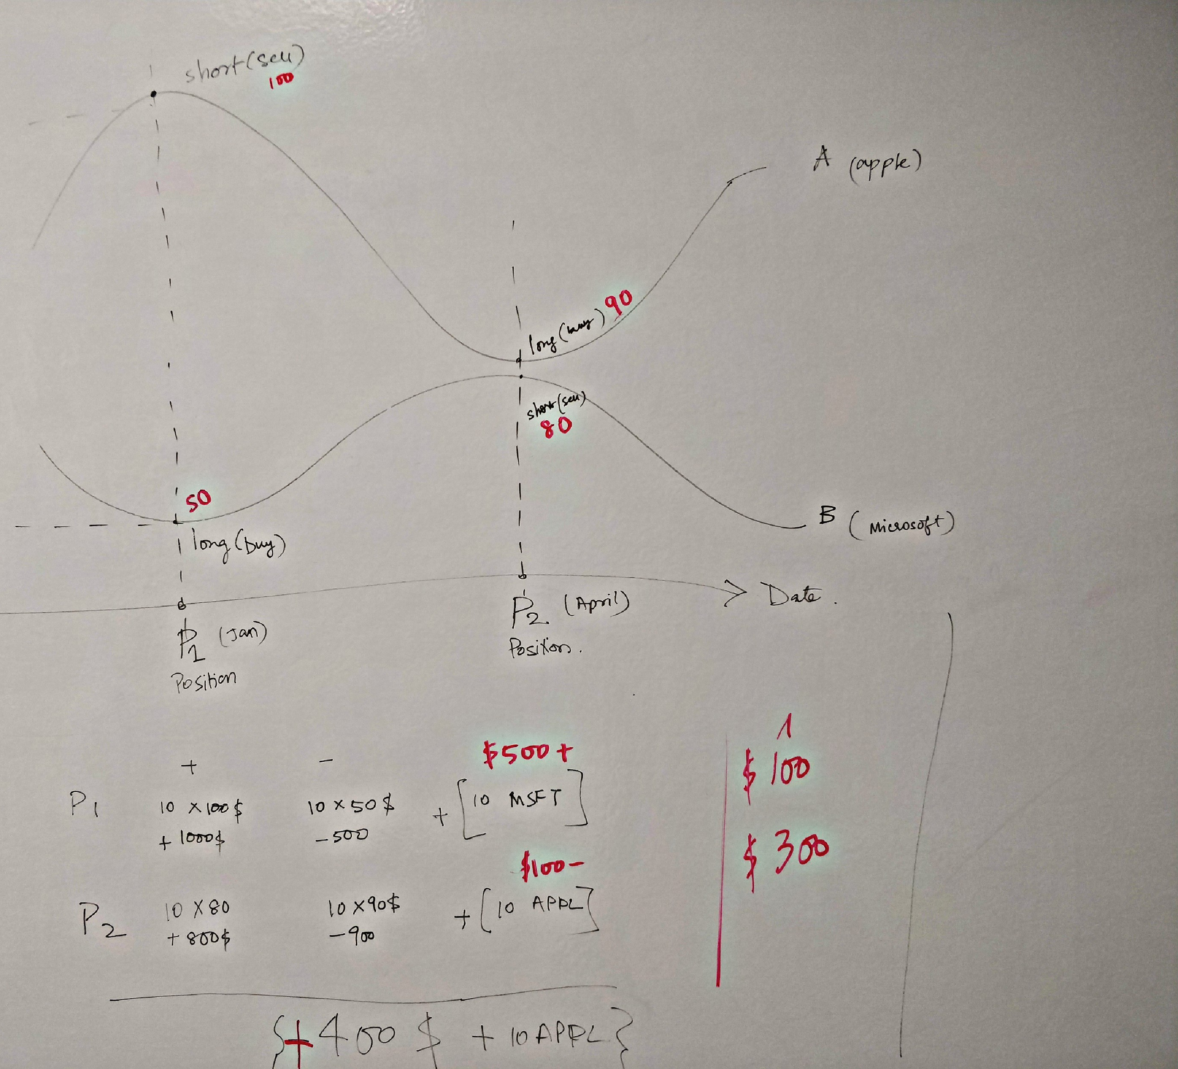
Trading Strategy - Pair Based Trading

Slide 5
Phase 1
Phase 2
Phase 3
Clustering
K-Means (Euclidean distance)
Time Series Analysis
Back Test using z-score
K-Medoids (Gowers distance)
Stationarity test with ADF
Moving Average Time series
Log Transformation of time series
Signal, Position Calculation, Strategy rules on Python (Jupyter Notebook)

Slide 6
Phase – 1 Which unsupervised clustering algorithm to use ?
K- Means
K- Medoids
Distance Measure : Euclidean
Distance Measure : Gowers
Variables allowed for selected distance measure : Numerical and Categorical
Variables allowed for selected distance measure : Only Numerical
Notes:
A loose definition of clustering could be “the process of organizing objects into groups whose members are similar in some way”. A cluster is therefore a collection of objects which are “similar” between them and are “dissimilar” to the objects belonging to other clusters. Distance-based clustering.
Given a set of points, with a notion of distance between points, grouping the points into some number of clusters, such that
internal (within the cluster) distances should be small i.e members of clusters are close/similar to each other.
external (intra-cluster) distances should be large i.e. members of different clusters are dissimilar.

Slide 7
Phase – 1 Which unsupervised clustering algorithm to use ?
K-Means:
We first decided on a value of k. Found a mean value and then plotted data points around it and kept doing that for several iterations till we made our final clusters.
K-Medoids:
Clustering is a modified form of K-Means clustering. K medoid is more robust to noise than K-Means clustering.
This means that, the algorithm is less sensitive to noise and outliers, compared to k-means.
Symbol | PE | Mcap | ROE
A | 23.8 | 20323 | 0.05
AAL | 8.4 | 20688 | 0.67
AAP | 19.2 | 9622 | 0
AAPL | 16.8 | 950145 | 0.4
Symbol | PE | Mcap | ROE | GICS Sector | GICS Sub Industry
A | 23.8 | 20323 | 0.05 | Health Care Equipment | Health Care Equipment
AAL | 8.4 | 20688 | 0.67 | Industrials | Airlines
AAP | 19.2 | 9622 | 0 | Consumer Discretionary | Automotive Retail
AAPL | 16.8 | 950145 | 0.4 | Information Technology | Technology Hardware, Storage & Peripherals
ABBV | 12.7 | 156942 | 1.21 | Health Care | Pharmaceuticals
ABC | 13.1 | 18631 | 0.32 | Health Care | Health Care Distributors
Figure 1: S&P Companies dataset for clustering

Slide 8
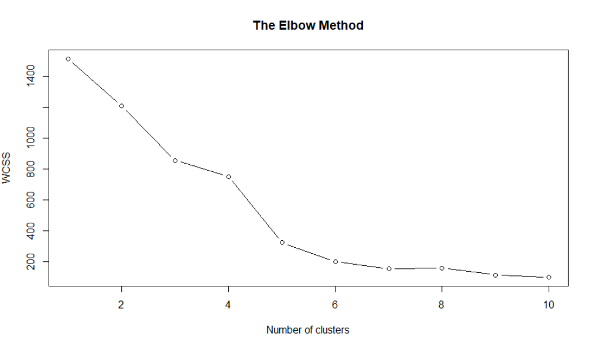
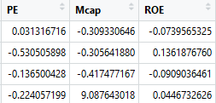
Phase – 1 a) K-Means
Data is scaled and numerical variables are set as features
Finding optimal number of clusters using the ‘Elbow Method’ in R
Fit dataset to K-Means library with k = 5 as seen from the adjoining elbow method.

Slide 9
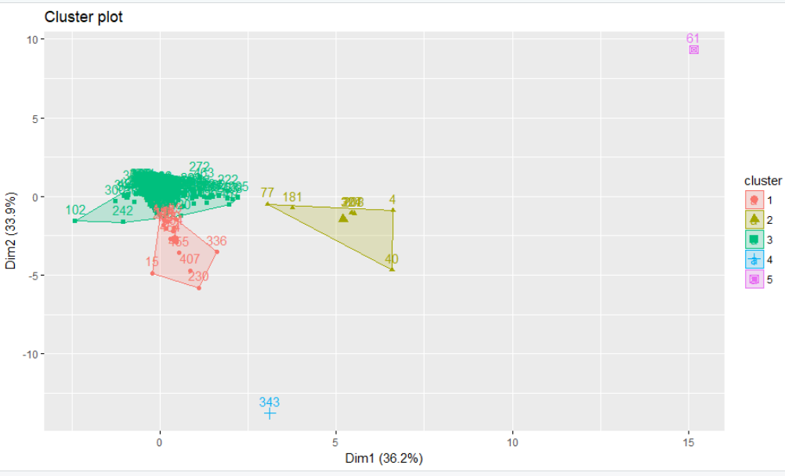
Phase – 1 a) K-Means
4. Visualize the five clusters using ‘fviz_cluster’ library

Slide 10
Phase – 1 b) K-Medoids (more weight applied to numerical variables)
Data is scaled, numerical and Categorical variables are set as features
Assigned weights to each feature. Weights=c(0,0,1,2,2,2)
Sub Industry (Categorical) = 1
PE Ratio (Numerical) = 2
Market Capitalization (Numerical) = 2
Return on Equity (Numerical) = 2
3. Found Gowers Distance and a
dissimilarity matrix for all 505 companies.
Number of distances measured = 505*505 = 255,025 observations

Slide 11
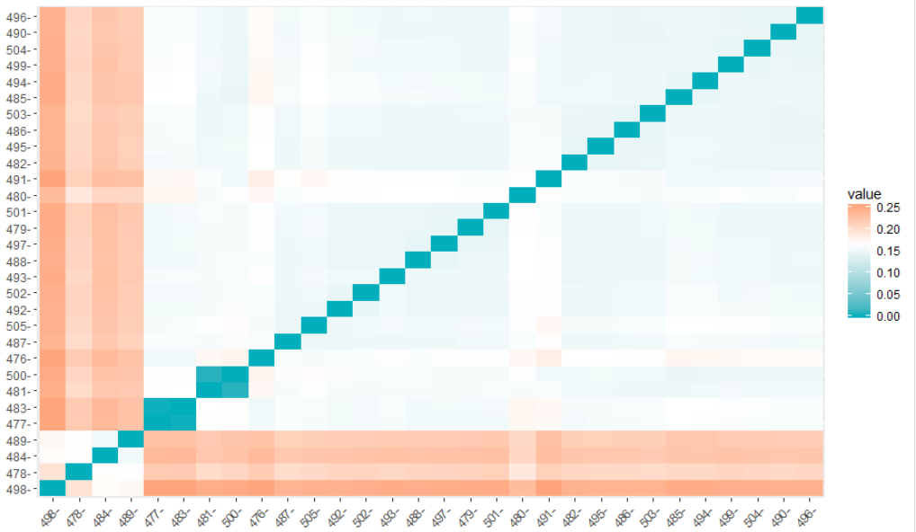
Phase – 1 b) K-Medoids (more weight applied to numerical variables)
4. Visual of the dissimilarity matrix of 25x25 companies

Slide 12
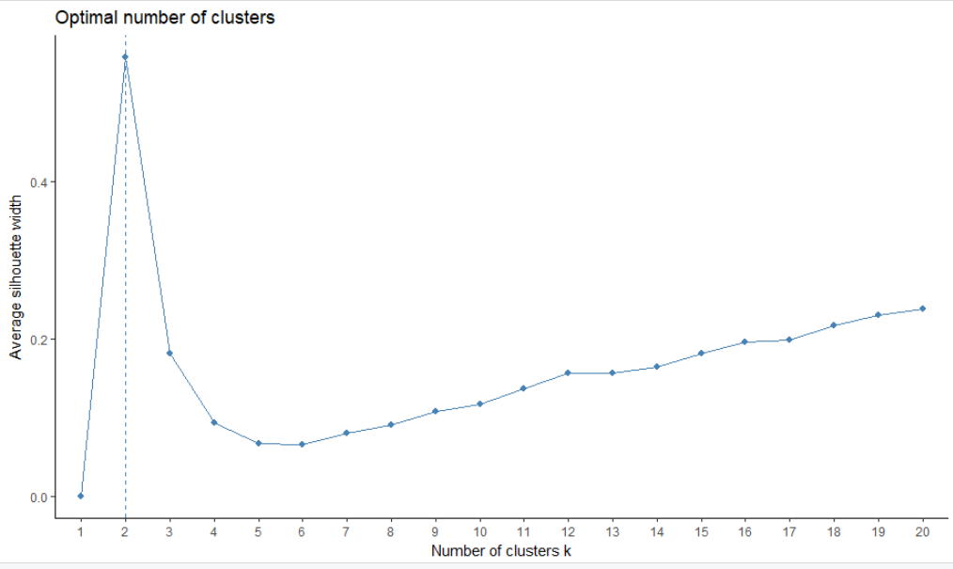
Phase – 1 b) K-Medoids (more weight applied to numerical variables)
5. Finding optimal number of clusters using the ‘Silhouette Method’ in R for Gowers Distance.
Optimal number of clusters with these weights (0,0,1,2,2,2)

Slide 13
Phase – 1 c) K-Medoids (more weight applied to Categorical variables)
Data is scaled , numerical and Categorical variables are set as features
2. Assigned weights to each feature.
Weights=c(0,2,2,1,1,1)
Sector (Categorical) = 2
Sub Industry (Categorical) = 2
PE Ratio (Numerical) = 1
Market Capitalization (Numerical) = 1
Return on Equity (Numerical) = 1
3. Found Gowers Distance and a dissimilarity
matrix for all 505 companies.
Number of distances measured = 505*505 = 255,025 observations

Slide 14
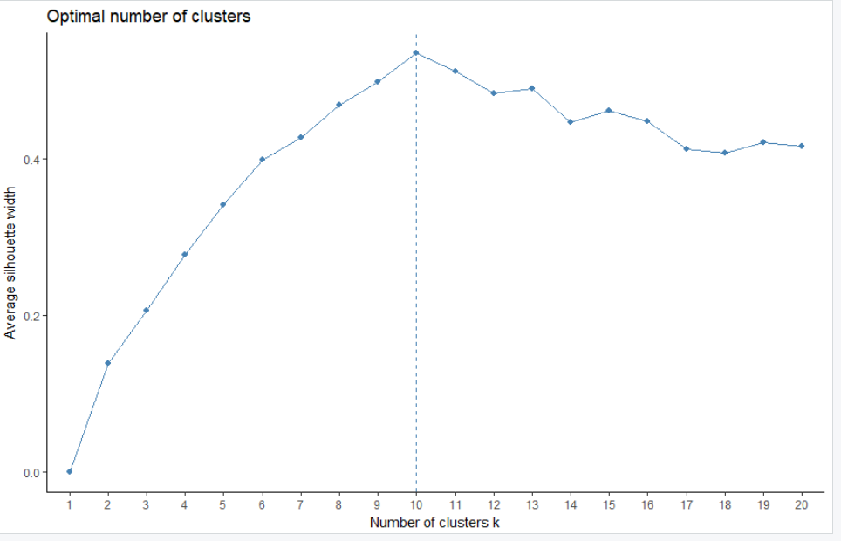
Phase – 1 c) K-Medoids (more weight applied to Categorical variables)
4. Finding optimal number of clusters using the ‘Silhouette Method’ in R for Gowers Distance.
Optimal number of clusters with these weights (0,2,2,1,1,1)

Slide 15
Phase 1 – Output format
CSV File with Cluster numbers against company names : Output from each clustering algorithm (cluster number against each company)
Name | GICS.Sector | GICS.Sub.Industry | PE | Mcap | ROE | Cluster
A | Health Care Equipment | Health Care Equipment | 0.031317 | -0.30933 | -0.07396 | 1
AAL | Industrials | Airlines | -0.53051 | -0.30564 | 0.136188 | 2
AAP | Consumer Discretionary | Automotive Retail | -0.1365 | -0.41748 | -0.0909 | 3
AAPL | Information Technology | Technology Hardware, Storage & Peripherals | -0.22406 | 9.087643 | 0.044673 | 4
ABBV | Health Care | Pharmaceuticals | -0.37363 | 1.071369 | 0.319217 | 1
ABC | Health Care | Health Care Distributors | -0.35904 | -0.32643 | 0.017558 | 1
ABMD | Health Care | Health Care Equipment | 3.296455 | -0.33213 | -0.0265 | 1
ABT | Health Care | Health Care Equipment | -0.03435 | 0.601875 | -0.08412 | 1
ACN | Information Technology | IT Consulting & Other Services | 0.034965 | 0.572497 | 0.048063 | 4

Slide 16
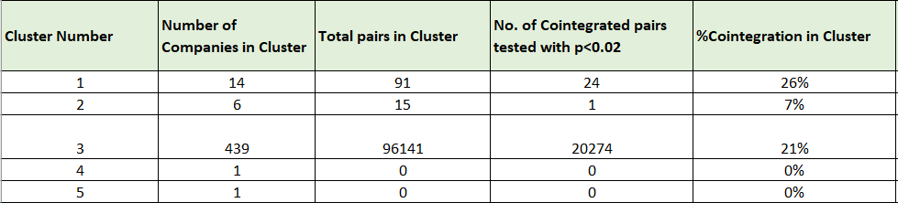
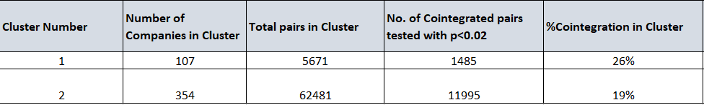
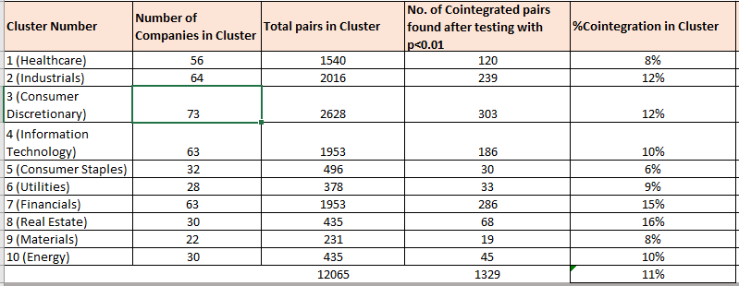
Phase 1 Results
Total Pairs tested for cointegration
96247
68152
12065
1,76,464 pairs tested for project
Clustered by K-Means
Clustered by K-Medoids
Clustered by K-Medoids

Slide 17
Phase 1
Phase 2
Phase 3
Clustering
K-Means (Euclidean distance)
Time Series Analysis
Back Test using z-score
K-Medoids (Gowers distance)
Stationarity test with ADF
Moving Average Time series
Log Transformation of time series
Signal, Position Calculation, Strategy rules on Python (Jupyter Notebook)

Slide 18
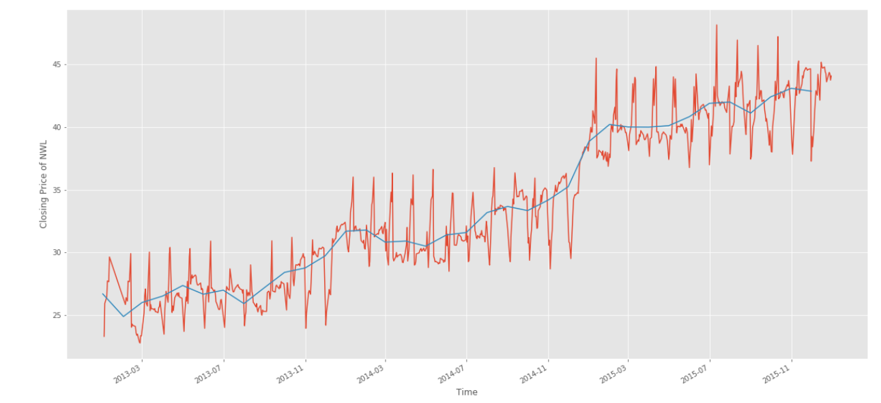
Phase – 2 Time Series Modelling and Analysis
Created Time series for each company for the years 2013 - 2015 and used the same for testing cointegration between created pairs.

Slide 19
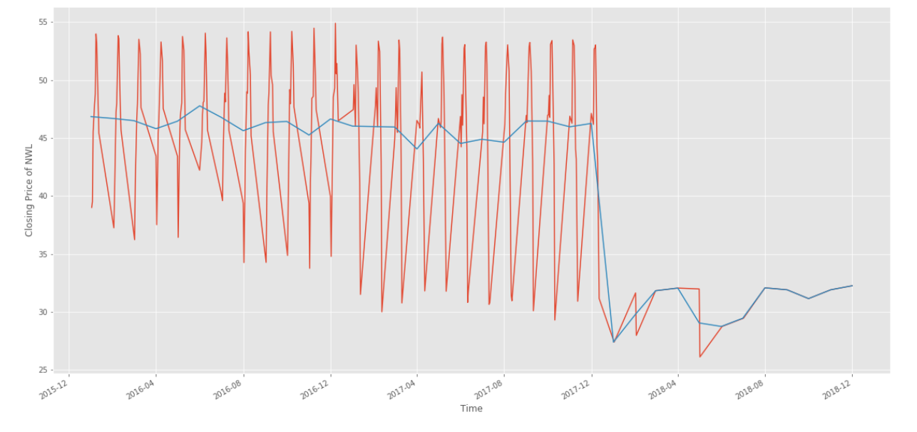
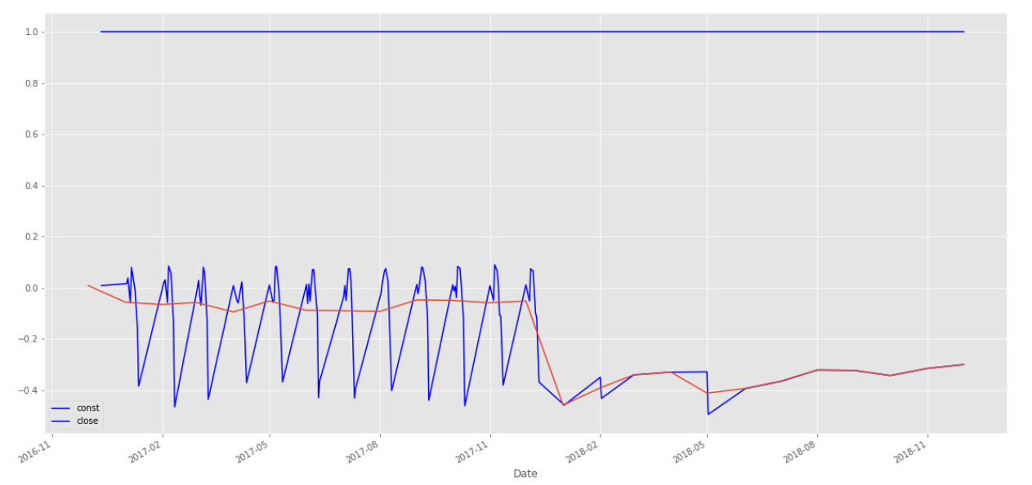
Phase – 2 Time Series Modelling and Analysis (NWL_2016-2018)
2. Time Series smoothening using log transformation and subtracting with moving average of the past 100 days.
dfNWL_logScale = np.log(dfNWL['close'])
NWLma = dfNWL_logScale.rolling(window=100).mean()
logScaleMinusMovingAverage1 = dfNWL_logScale - NWLma
Notes:
Smoothing is a technique applied to time series to remove the fine-grained variation between time steps.
The hope of smoothing is to remove noise and better expose the signal of the underlying causal processes. Moving averages are a simple and common type of smoothing used in time series analysis and time series forecasting.
Smoothing is useful as a
The rolling() function on the Series Pandas object will automatically group observations into a window. You can specify the window size, and by default a trailing window is created. Once the window is created, we can take the mean value, and this is our transformed dataset.data preparation technique as it can reduce the random variation in the observations and better expose the structure of the underlying causal processes.

Slide 20
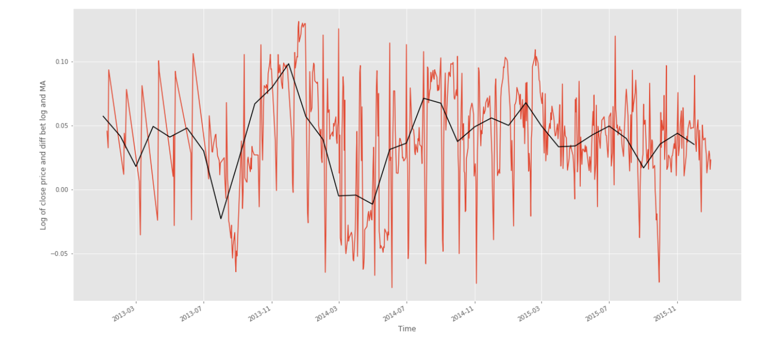
Phase – 2 Time Series Modelling and Analysis (NWL_2013-2015)
2. Time Series smoothening using log transformation and subtracting with moving average of the past 100 days.
dfNWL_logScale = np.log(dfNWL['close'])
NWLma = dfNWL_logScale.rolling(window=100).mean()
logScaleMinusMovingAverage1 = dfNWL_logScale - NWLma
Notes:
Smoothing is a technique applied to time series to remove the fine-grained variation between time steps.
The hope of smoothing is to remove noise and better expose the signal of the underlying causal processes. Moving averages are a simple and common type of smoothing used in time series analysis and time series forecasting.
Smoothing is useful as a
The rolling() function on the Series Pandas object will automatically group observations into a window. You can specify the window size, and by default a trailing window is created. Once the window is created, we can take the mean value, and this is our transformed dataset.data preparation technique as it can reduce the random variation in the observations and better expose the structure of the underlying causal processes.

Slide 21
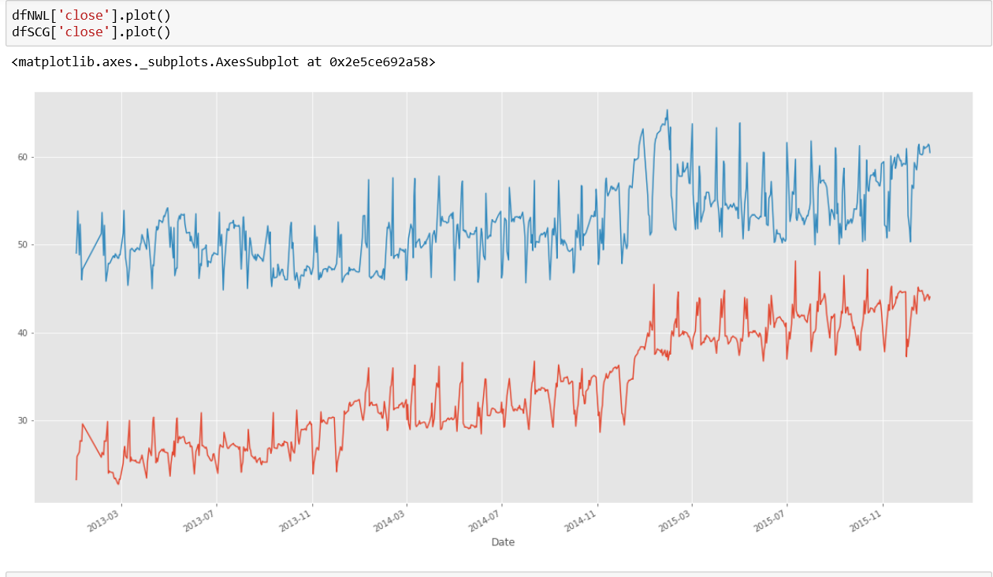
Phase – 2 Time Series Modelling and Analysis
3. Testing for Cointegration using Linear Regression
Y=A*x1 + B*x2 We are trying to find the value of A and B such that Y is I(0) -> or stationary.
A common way to do this in time series is to use linear regression to estimate B’ in the following model : X2 = A’ + B’*x1 + c
The idea is that if these two are cointegrated, then we can remove x2’s dependency on x1, leaving behind stationary noise.
X2 - B’*x1 = A’ + c (where Y = A’+c)
So, if we can prove that Y is stationary, then the set (x1,x2) are cointegrated.
Notes:
Smoothing is a technique applied to time series to remove the fine-grained variation between time steps.
The hope of smoothing is to remove noise and better expose the signal of the underlying causal processes. Moving averages are a simple and common type of smoothing used in time series analysis and time series forecasting.
Smoothing is useful as a
The rolling() function on the Series Pandas object will automatically group observations into a window. You can specify the window size, and by default a trailing window is created. Once the window is created, we can take the mean value, and this is our transformed dataset.data preparation technique as it can reduce the random variation in the observations and better expose the structure of the underlying causal processes.
Time Series : https://blog.datarobot.com/ordinary-least-squares-in-python

Slide 22
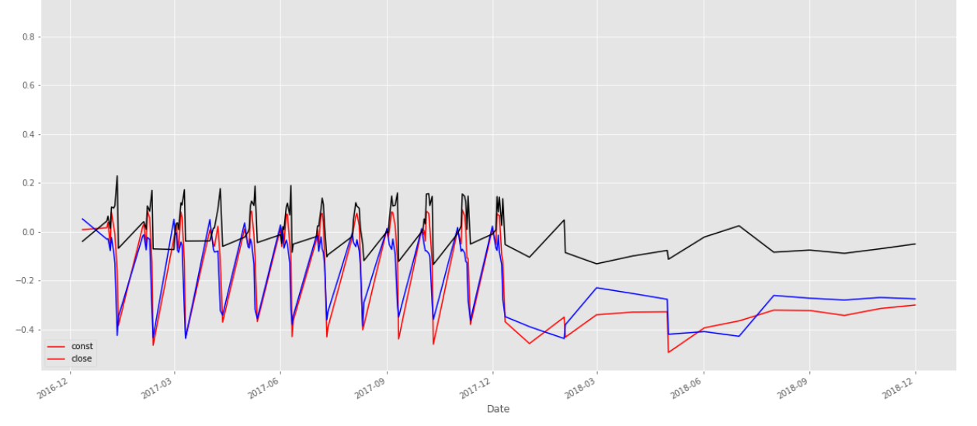
Phase – 2 Time Series Modelling and Analysis
4. Created a linearly combined time series (Z) of the pair of companies using Ordinary Least Square Regression to test the stationarity of the combined series for checking cointegration of the pair.
logScaleMinusMovingAverage1 = sm.add_constant(logScaleMinusMovingAverage1)
results = sm.OLS(logScaleMinusMovingAverage2,logScaleMinusMovingAverage1['close']).fit()
b = results.params['close']
z = logScaleMinusMovingAverage1['close'] - (b * logScaleMinusMovingAverage2)
Notes:
Smoothing is a technique applied to time series to remove the fine-grained variation between time steps.
The hope of smoothing is to remove noise and better expose the signal of the underlying causal processes. Moving averages are a simple and common type of smoothing used in time series analysis and time series forecasting.
Smoothing is useful as a
The rolling() function on the Series Pandas object will automatically group observations into a window. You can specify the window size, and by default a trailing window is created. Once the window is created, we can take the mean value, and this is our transformed dataset.data preparation technique as it can reduce the random variation in the observations and better expose the structure of the underlying causal processes.

Slide 23
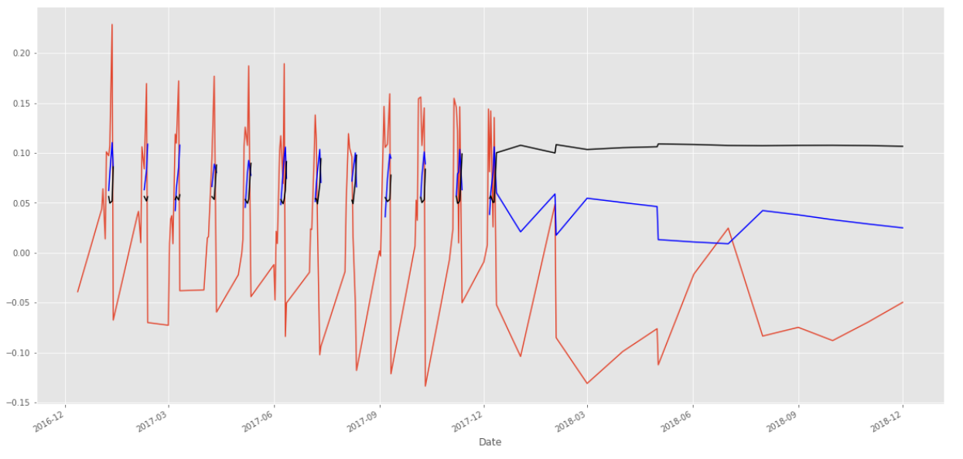
Phase – 2 Time Series Modelling and Analysis
5. Testing stationarity of the linearly combined series by the Rolling window test.
Used the Augmented Dickey Fuller test using the ‘statsmodels.tsa.stattools’ library because we cannot test cointegration for 1,76,000 pairs visually.
z.plot()
m = z.rolling(window=50).mean()
m.plot(color='blue')
std = z.rolling(window=50).std()
std.plot(color='black')
Notes:
Smoothing is a technique applied to time series to remove the fine-grained variation between time steps.
The hope of smoothing is to remove noise and better expose the signal of the underlying causal processes. Moving averages are a simple and common type of smoothing used in time series analysis and time series forecasting.
Smoothing is useful as a
The rolling() function on the Series Pandas object will automatically group observations into a window. You can specify the window size, and by default a trailing window is created. Once the window is created, we can take the mean value, and this is our transformed dataset.data preparation technique as it can reduce the random variation in the observations and better expose the structure of the underlying causal processes.

Slide 24
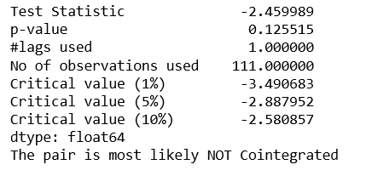
Phase – 2 Time Series Modelling and Analysis
6. Found cointegration of each pair by ADFT
7. Testing Cointegration level of each cluster found from K-Means or K-Medoid clustering of the companies.
Notes:
Smoothing is a technique applied to time series to remove the fine-grained variation between time steps.
The hope of smoothing is to remove noise and better expose the signal of the underlying causal processes. Moving averages are a simple and common type of smoothing used in time series analysis and time series forecasting.
Smoothing is useful as a
The rolling() function on the Series Pandas object will automatically group observations into a window. You can specify the window size, and by default a trailing window is created. Once the window is created, we can take the mean value, and this is our transformed dataset.data preparation technique as it can reduce the random variation in the observations and better expose the structure of the underlying causal processes.

Slide 25
Phase 2 Results
Total cointegrated pairs proceed to Phase 3 for back testing
20,299
13,480
1,329
35,108 pairs tested for project
Clustered by K-Means
Clustered by K-Medoids
Clustered by K-Medoids

Slide 26
Phase 1
Phase 2
Phase 3
Clustering
K-Means (Euclidean distance)
Time Series Analysis
Back Test using z-score
K-Medoids (Gowers distance)
Stationarity test with ADF
Moving Average Time series
Log Transformation of time series
Signal, Position Calculation, Strategy rules on Python (Jupyter Notebook)

Slide 27
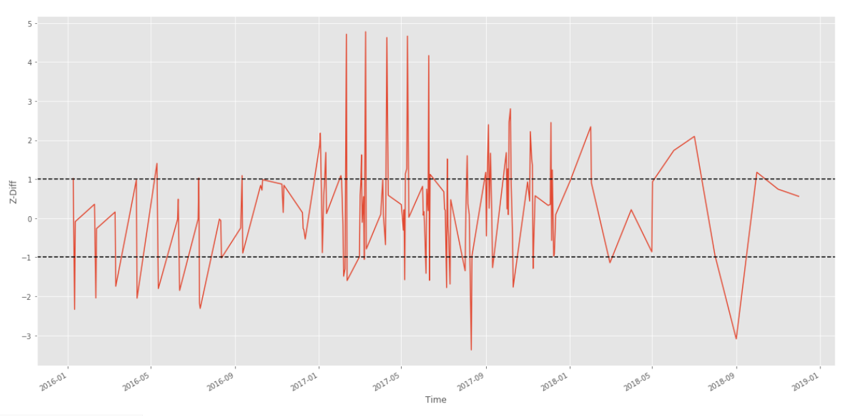
Phase – 3 Back Testing the cointegrated pairs to find cumulative return for time period – 2016-2018
Z_Diff = [∆ Pa / std(∆ Pa) ] – [∆ Pb / std(∆ Pb)]
Notes:
Smoothing is a technique applied to time series to remove the fine-grained variation between time steps.
The hope of smoothing is to remove noise and better expose the signal of the underlying causal processes. Moving averages are a simple and common type of smoothing used in time series analysis and time series forecasting.
Smoothing is useful as a
The rolling() function on the Series Pandas object will automatically group observations into a window. You can specify the window size, and by default a trailing window is created. Once the window is created, we can take the mean value, and this is our transformed dataset.data preparation technique as it can reduce the random variation in the observations and better expose the structure of the underlying causal processes.

Slide 28
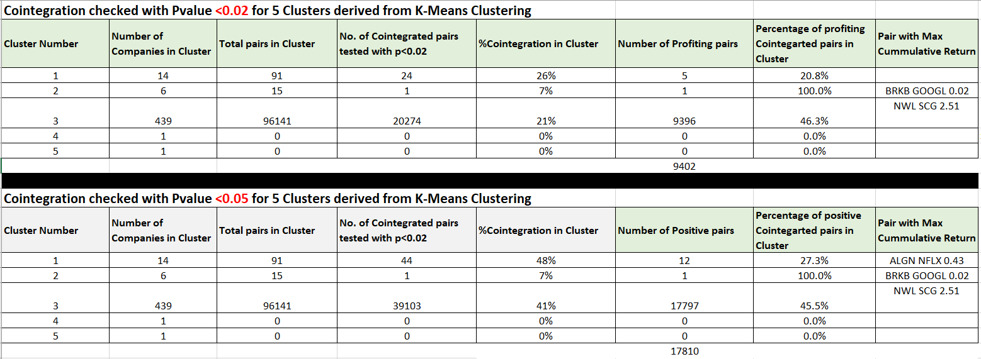
Phase – 3 Results of cointegrated pairs and positive cumulative return for clusters – found by K Means Clustering
Notes:
Smoothing is a technique applied to time series to remove the fine-grained variation between time steps.
The hope of smoothing is to remove noise and better expose the signal of the underlying causal processes. Moving averages are a simple and common type of smoothing used in time series analysis and time series forecasting.
Smoothing is useful as a
The rolling() function on the Series Pandas object will automatically group observations into a window. You can specify the window size, and by default a trailing window is created. Once the window is created, we can take the mean value, and this is our transformed dataset.data preparation technique as it can reduce the random variation in the observations and better expose the structure of the underlying causal processes.

Slide 29
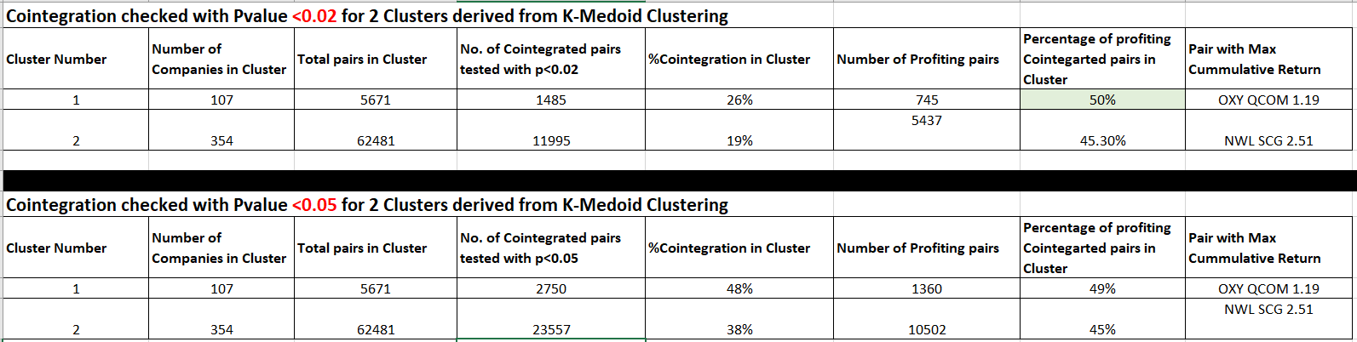
Phase – 3 Results of cointegrated pairs and positive cumulative return for clusters – found by K Medoid Clustering (2 clusters with weights applied to numerical variables)
Notes:
Smoothing is a technique applied to time series to remove the fine-grained variation between time steps.
The hope of smoothing is to remove noise and better expose the signal of the underlying causal processes. Moving averages are a simple and common type of smoothing used in time series analysis and time series forecasting.
Smoothing is useful as a
The rolling() function on the Series Pandas object will automatically group observations into a window. You can specify the window size, and by default a trailing window is created. Once the window is created, we can take the mean value, and this is our transformed dataset.data preparation technique as it can reduce the random variation in the observations and better expose the structure of the underlying causal processes.

Slide 30
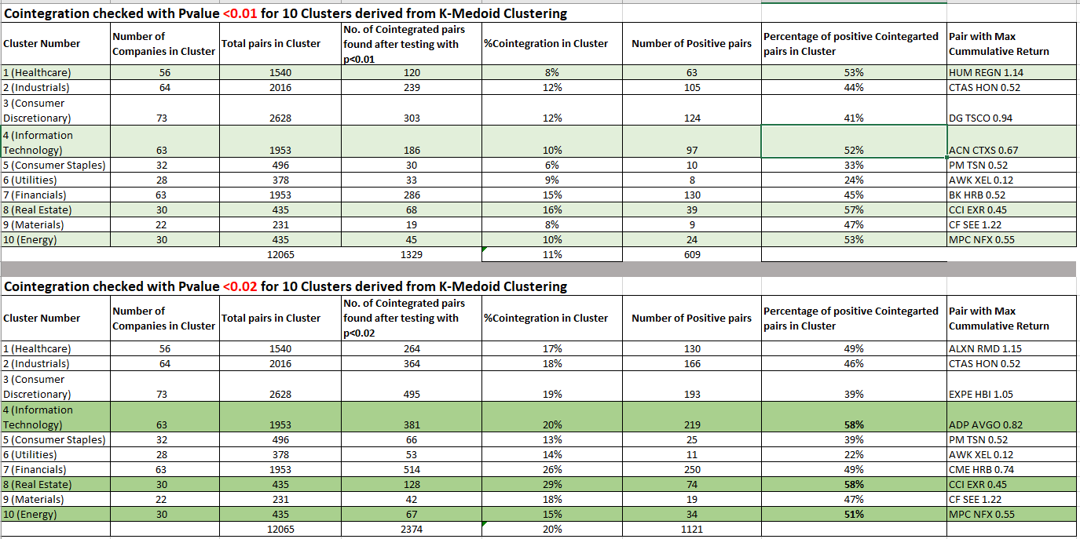
Phase – 3 Results of cointegrated pairs and positive cumulative return for clusters – found by K Medoid Clustering (10 clusters with more weights applied to categorical variables)
Notes:
Smoothing is a technique applied to time series to remove the fine-grained variation between time steps.
The hope of smoothing is to remove noise and better expose the signal of the underlying causal processes. Moving averages are a simple and common type of smoothing used in time series analysis and time series forecasting.
Smoothing is useful as a
The rolling() function on the Series Pandas object will automatically group observations into a window. You can specify the window size, and by default a trailing window is created. Once the window is created, we can take the mean value, and this is our transformed dataset.data preparation technique as it can reduce the random variation in the observations and better expose the structure of the underlying causal processes.

Slide 31
Final Results
Found 609 profitable cointegrated pairs by Med-10(0.01) [609(me10)+745(me2)+9402(mn5) = 10,756 pairs in total]
The most profitable cointegrated pairs belonged to following industries (clusters): 1. Healthcare (53% are profitable) 2. Information Technology (58% are profitable) 3. Real Estate (58% are profitable) 4. Energy (53% are profitable)
The best clustering algorithm from pair based trading perspective is K-Medoid clustering using Gowers Distance giving more weightage to sector and sub sector instead of prices.
More positive cointegrated pairs were found when the test for cointegration was changed from a p-value threshold of 0.05 to 0.01
P-Value is inversely proportional to the number of cointegrated pairs found.
The pair with maximum cumulative return is (NWL , SCG) with a return of 2.51
Notes:
Smoothing is a technique applied to time series to remove the fine-grained variation between time steps.
The hope of smoothing is to remove noise and better expose the signal of the underlying causal processes. Moving averages are a simple and common type of smoothing used in time series analysis and time series forecasting.
Smoothing is useful as a
The rolling() function on the Series Pandas object will automatically group observations into a window. You can specify the window size, and by default a trailing window is created. Once the window is created, we can take the mean value, and this is our transformed dataset.data preparation technique as it can reduce the random variation in the observations and better expose the structure of the underlying causal processes.

Slide 32
References
(n.d.). Retrieved from https://www.quantopian.com/posts/tag/pairs-trading/newest
(n.d.). Retrieved from https://machinelearningmastery.com/moving-average-smoothing-for-time-series-forecasting-python/
(n.d.). Retrieved from https://www.r-bloggers.com/the-ultimate-guide-to-partitioning-clustering/
(n.d.). Retrieved from https://github.com/kartikeyathakur/pairtrading
(n.d.). Retrieved from https://cran.r-project.org/web/packages/kmed/vignettes/kmedoid.html
Udemy Course– Time Series Analysis & Forecasting. (n.d.). Retrieved from Udemy.
Notes:
Smoothing is a technique applied to time series to remove the fine-grained variation between time steps.
The hope of smoothing is to remove noise and better expose the signal of the underlying causal processes. Moving averages are a simple and common type of smoothing used in time series analysis and time series forecasting.
Smoothing is useful as a
The rolling() function on the Series Pandas object will automatically group observations into a window. You can specify the window size, and by default a trailing window is created. Once the window is created, we can take the mean value, and this is our transformed dataset.data preparation technique as it can reduce the random variation in the observations and better expose the structure of the underlying causal processes.

